Slide 1
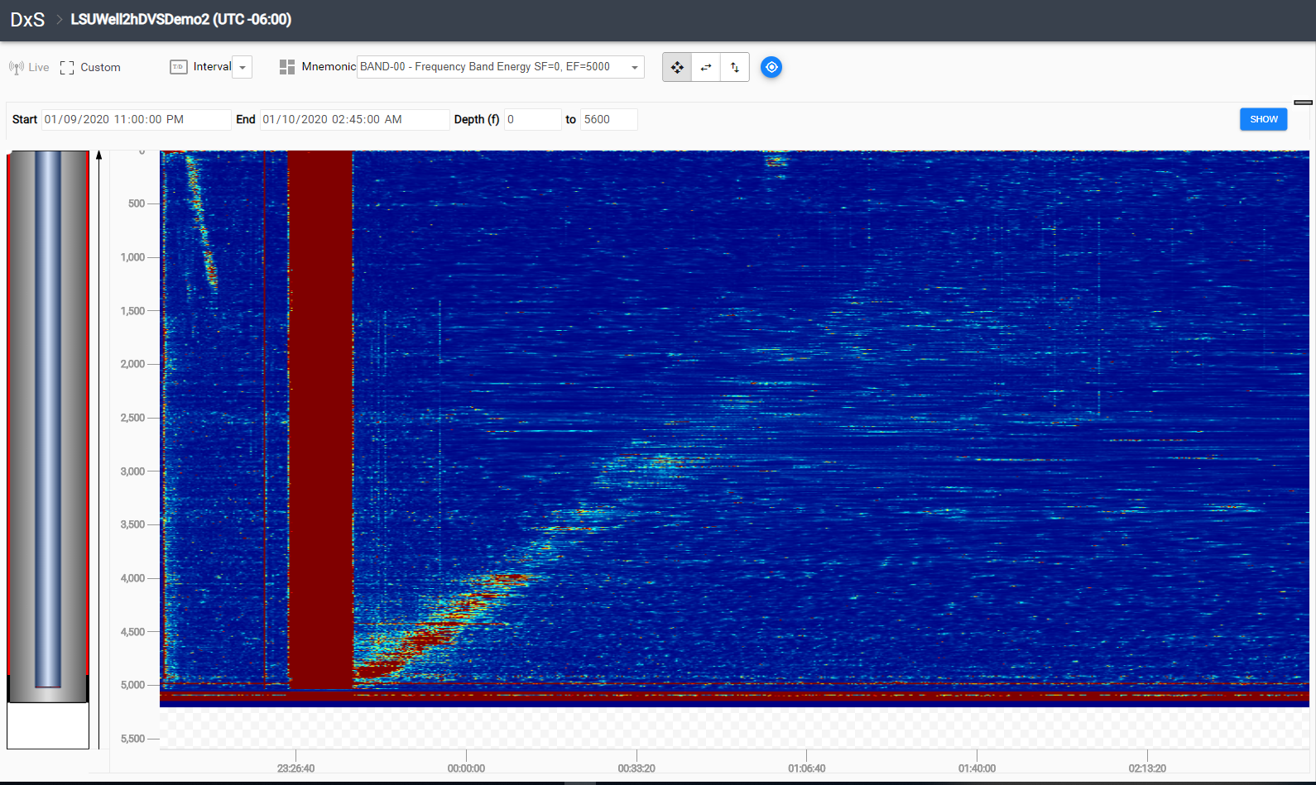
N2 Gas Fill Frequency band: 0 – 5000 Hz (Summation of all acoustic source energy in all the different frequency bands)
Color Map Filtering: 2000
Notes:
Color map: 10612400

Slide 2
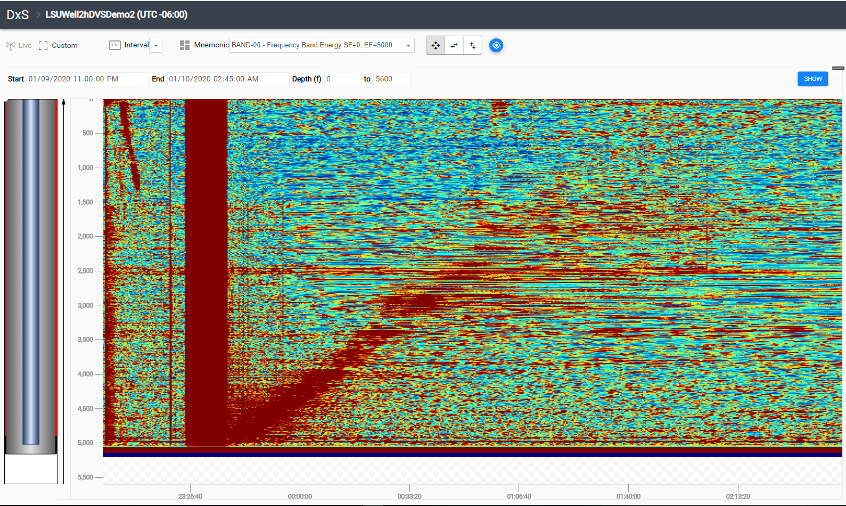
N2 Gas Fill Frequency band: 0 – 5000 Hz (Summation of all acoustic source energy in all the different frequency bands)
Color Map Filtering: 150
Notes:
Color map: 10612400

Slide 3
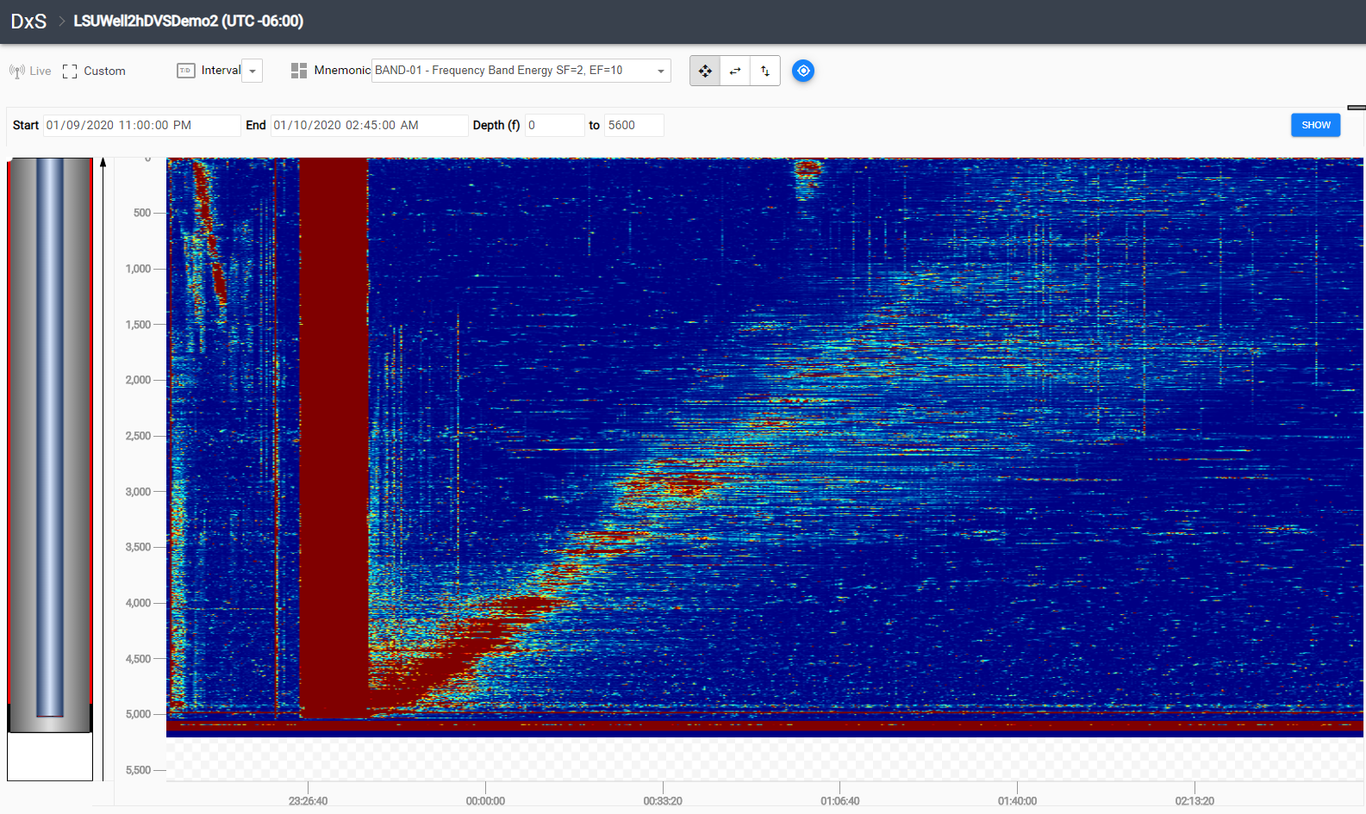
N2 Gas Fill and Gas Rise Frequency band: 2 – 10 Hz
Color Map Filtering: 150
Notes:
Color map: 10612400

Slide 4
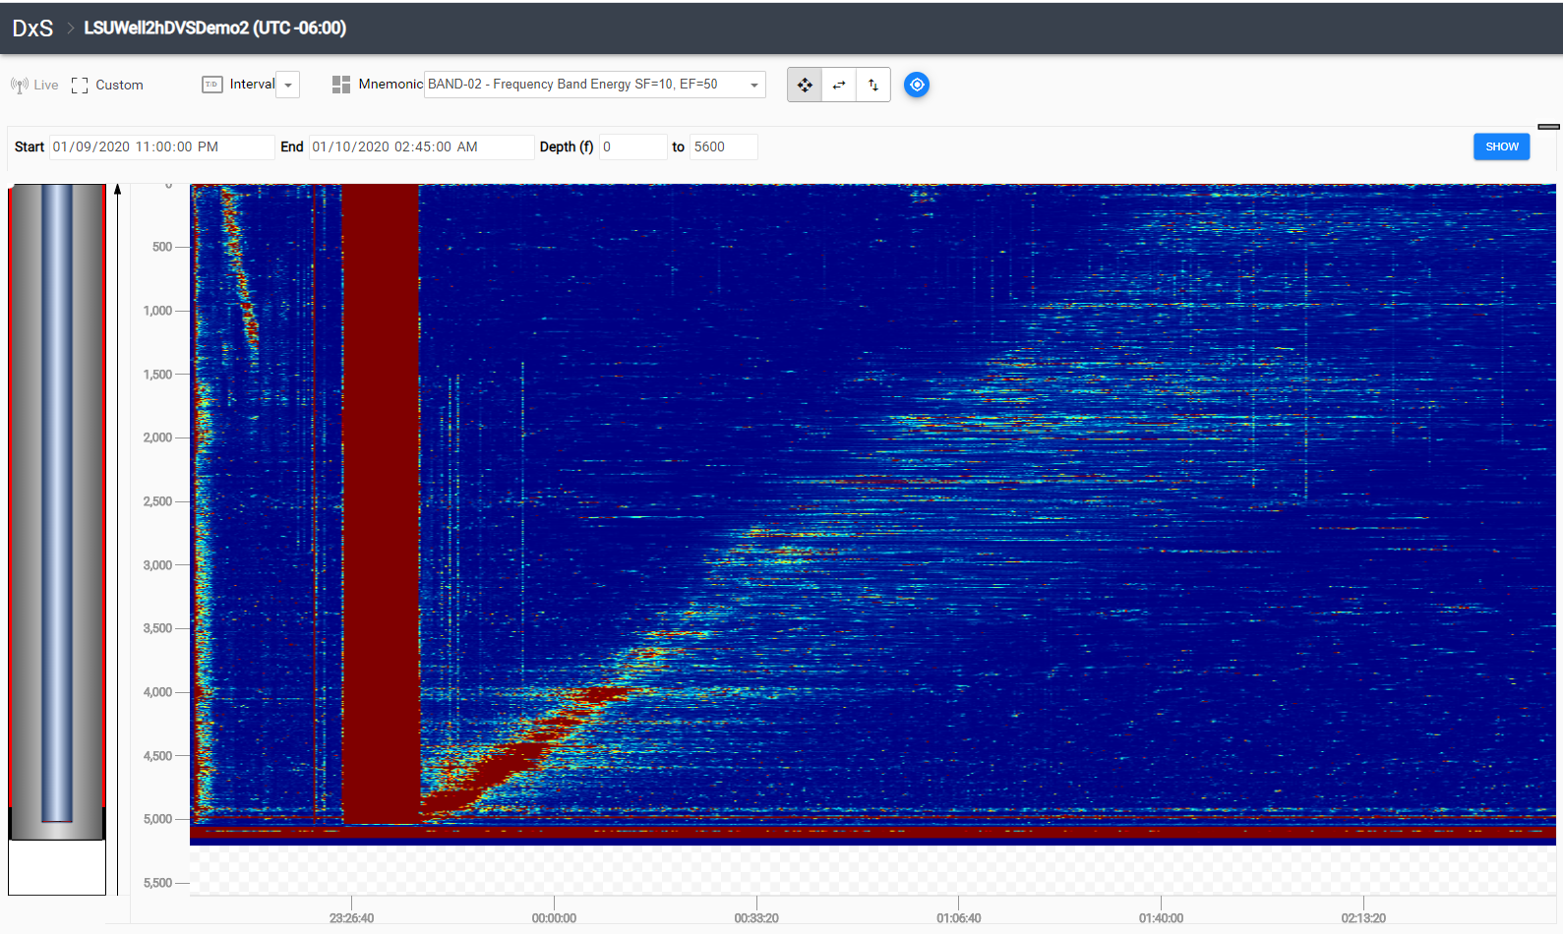
N2 Gas Fill and Gas Rise Frequency band: 10 – 50 Hz
Color Map Filtering: 150

Slide 5
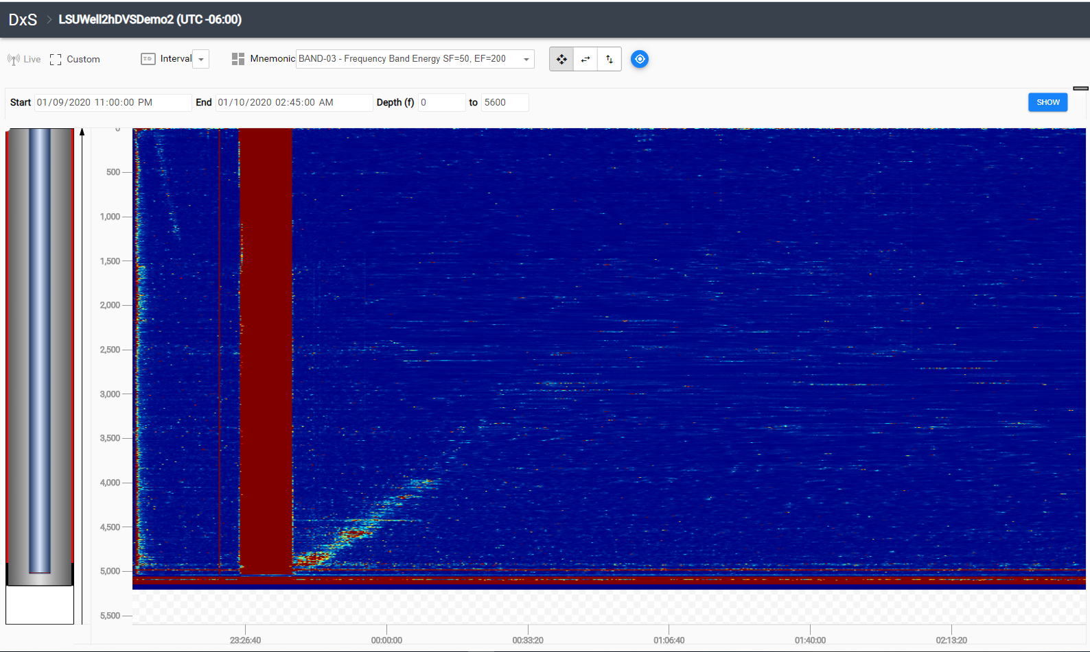
N2 Gas Fill and Gas Rise Frequency band: 50 – 200 Hz
Color Map Filtering: 150

Slide 6
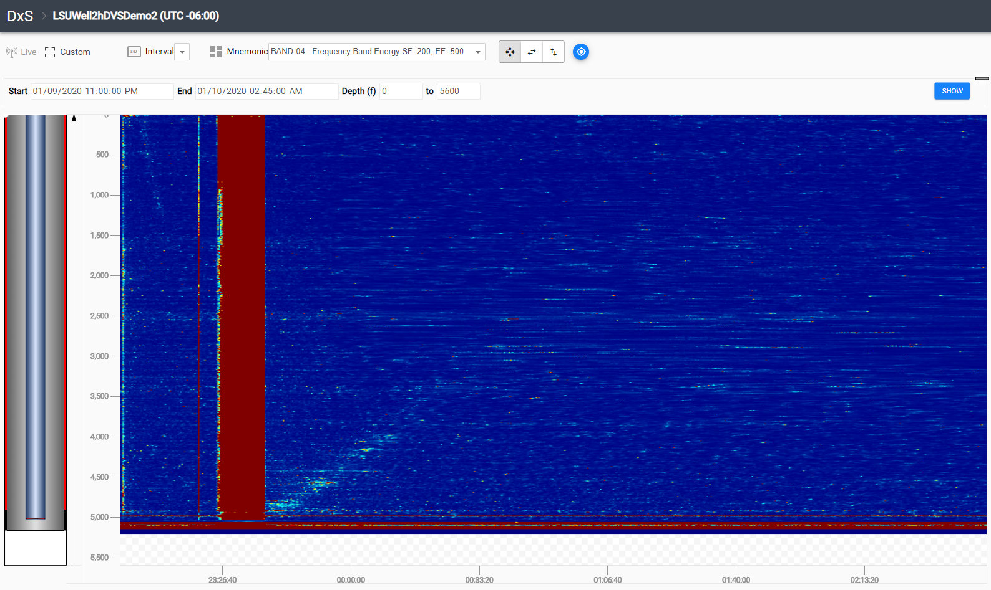
N2 Gas Fill and Gas Rise Frequency band: 200 – 500 Hz
Color Map Filtering: 150

Slide 7
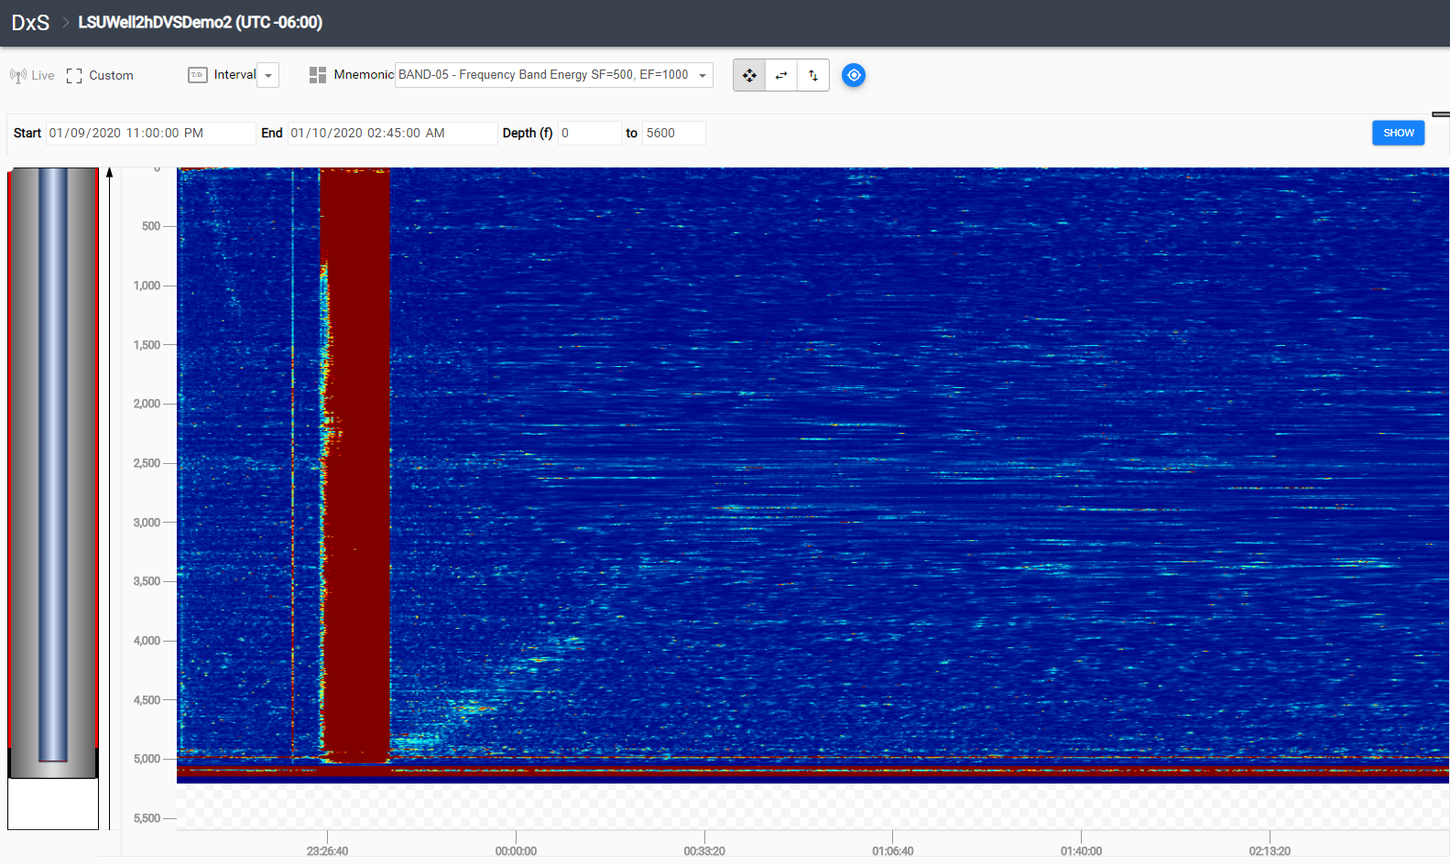
N2 Gas Fill and Gas Rise Frequency band: 500 – 1000 Hz
Color Map Filtering: 150

Slide 8
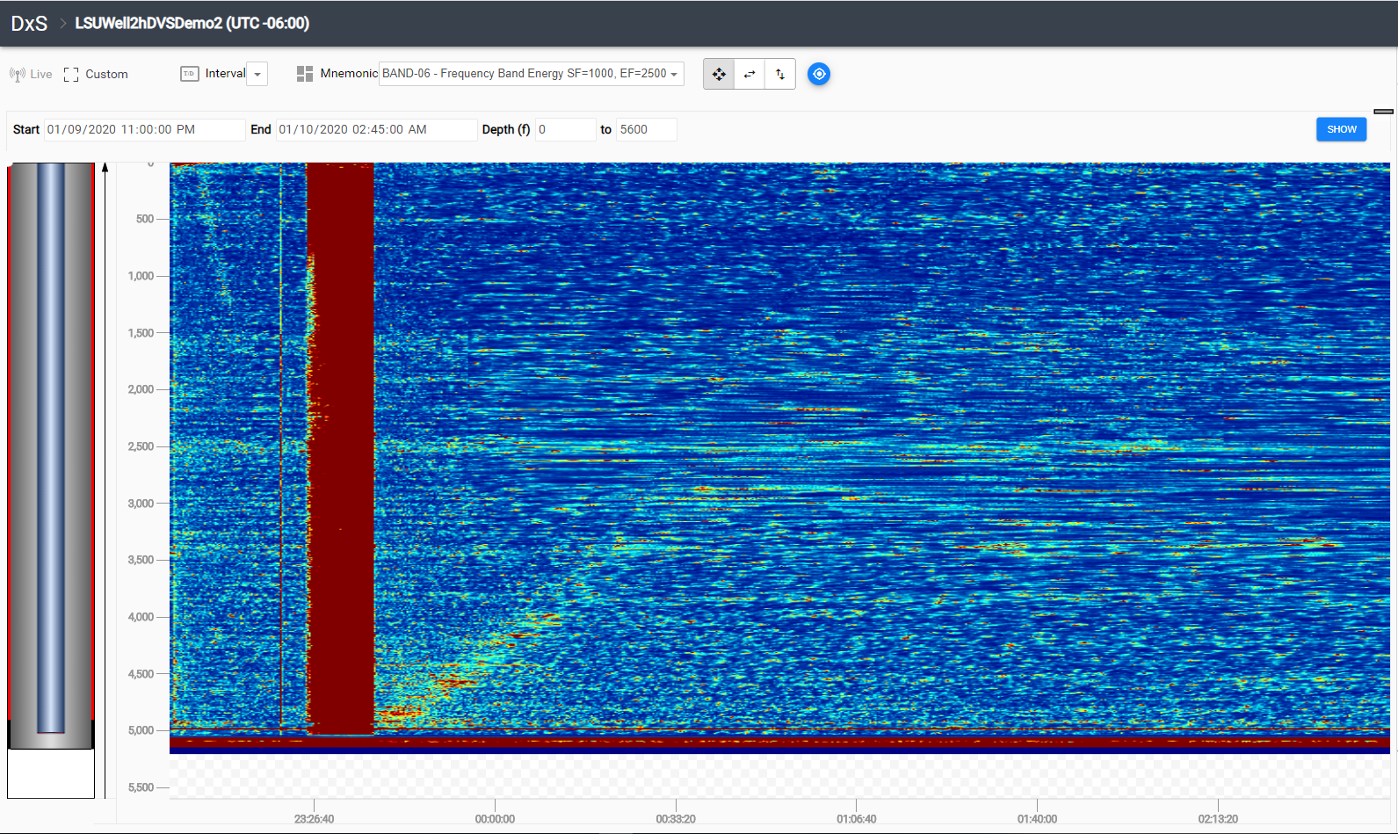
N2 Gas Fill and Gas Rise Frequency band: 1000 – 2500 Hz
Color Map Filtering: 150

Slide 9
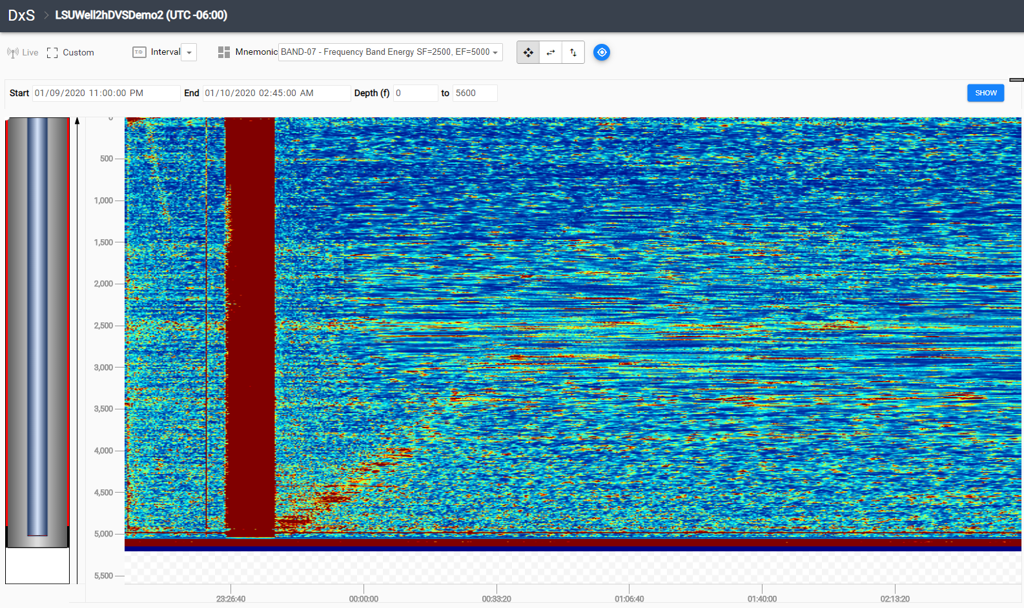
N2 Gas Fill and Gas Rise Frequency band: 2500 – 5000 Hz
Color Map Filtering: 150

